Slide 1
RFID
Door Lock System
Internet of Things Essentials
Presented By:
Subhikshaa S (210701264)
Tamil Priya V (210701282)

Slide 2
AGENDA
ABSTRACT
INTRODUCTION
OBJECTIVE
LITERATURE SURVEY
a. KEY CHALLENGES
b. MOTIVATION
EXISTING SYSTEM
PROPOSED SYSTEM
MODULES
SYSTEM ARCHITECTURE
CONCLUSION AND FUTURE ENHANCEMENTS
REFERENCES

Slide 3
ABSTRACT
The RFID door lock system using Arduino Uno is an IoT project aimed at enhancing security and access control. By integrating RFID technology with Arduino Uno, users can unlock doors with authorized RFID tags or cards. The system provides real-time monitoring and control on access attempts, ensuring accountability and safety. Its design allows for easy integration into existing infrastructure, making it a versatile solution for various applications requiring secure access control. The quick response of authorization makes it more efficient.

Slide 4
INTRODUCTION
The RFID door lock system utilizing Arduino Uno demonstrates the fusion of technology, offering a sophisticated yet accessible approach to access and control management. By leveraging RFID technology, users can securely unlock doors with authorized tags or cards. This project showcases the power of IoT in enhancing security measures, providing a modular and adaptable solution suitable for various day-to-day applications. This introduction sets the stage for exploring the intricacies and benefits of the RFID door lock system in detail.

Slide 5
OBJECTIVE
To create a robust and user-friendly access control solution.
To enhance security by allowing only authorized individuals to unlock doors using RFID tags or cards.
To provide reliable real-time monitoring facilities.
To ensure quick response system.
To provide scalable solution for access management in various environments.

Slide 6
LITERATURE SURVEY
[1] RFID Security and Privacy (Li et al., 2022) provides an in-depth analysis of security and privacy issues in RFID systems, addressing potential threats and countermeasures.
[2] RFID and Alert System Using Arduino (Avcu, 2021) details the design and implementation of an RFID-based door lock system offering practical insights into Arduino-based access control systems and discusses alert mechanisms to enhance system responsiveness.
[3] RFID and the Internet of Things (Chabanne et al., 2013) explains the role of RFID in the context of the Internet of Things (IoT), highlighting its potential to connect physical objects.

Slide 7
LITERATURE SURVEY
[4]RFID-Enabled Sensor Design and Applications (Rida et al., 2010) describes the use of RFID technology in sensor design and its applications across different industries. It provides insights into integrating RFID with other sensing technologies to create innovative applications.
[5] Arduino Keyless Door Lock System With Keypad and LCD (Avcu, 2021) illustrates the construction of a keyless door lock system using Arduino, integrating a keypad and LCD display. It offers a step-by-step guide, focusing on both the hardware and software aspects of the project.

Slide 8
KEY CHALLENGES
Maintenance
Cost and Scalability
Usage of appropriate tags
Safety and Compliance
Fast Detection / Quick Sensing
Installation complexity

Slide 9
MOTIVATION
An RFID door lock system project combines security and convenience, offering keyless access that's harder to duplicate or misplace. Using radio frequency, security can be assured for a maximum level. Safety is every person’s concern for which these RFID gives a solution of making it secure and compatible. It is the lock system which at times is easier to break into or damage, inspired us to include these radio frequency integrated sensors and tags to ensure an additional layer of security.

Slide 10
EXISTING SYSTEM
The RFID door lock system provides secure access control by utilizing radio-frequency identification (RFID) technology. Users are given unique RFID tags or cards that they present to the system's scanner for authentication. When a tag is scanned, the system reads its embedded data to determine whether it is authorized. If the tag's credentials match those in the system's database, the door lock is triggered to open, allowing access. If the tag is unauthorized, the door remains locked, ensuring security.

Slide 11
PROPOSED SYSTEM
In the proposed system, an additional feature is introduced where an LED light is triggered to turn on immediately after the RFID door lock system grants access. Once a valid RFID tag is scanned and the door unlocks, a signal is sent to the LED, causing it to light up. This serves a dual purpose: indicating to the user that the door is unlocked and providing illumination to enhance safety and visibility as they enter. This feature is especially useful in dark or low-light environments, like evening hours or underground parking areas, offering an extra layer of convenience and security.

Slide 12
MODULES
Arduino UNO
RFID module
RFID tags
LCD screen and I2C module
SG90 Servo motor
LED bulbs
Door lock
Jumper wires

Slide 13

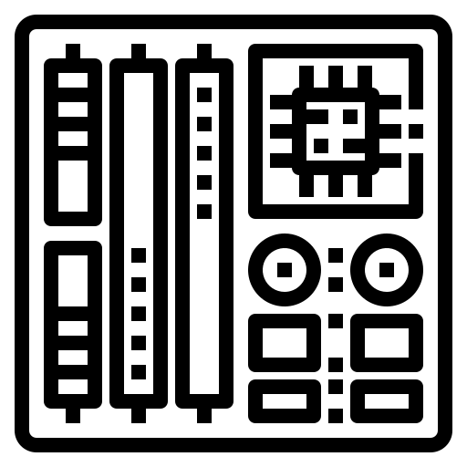



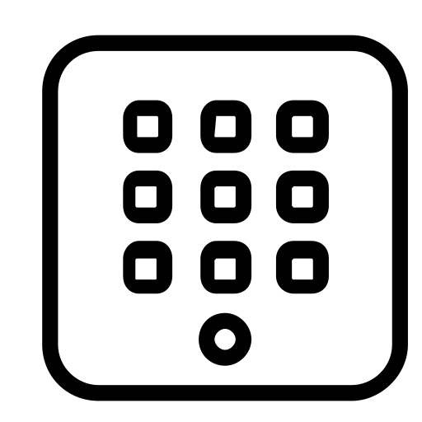
SYSTEM ARCHITECTURE
LCD DISPLAY
LED Bulb
ARDUINO UNO
Authorize
PIN
Keypad
RFID
Scan & authorize

Slide 14
CONCLUSION
Using Radio Frequency Identification (RFID) technology to enable keyless entry, offers significant advantages over traditional lock-and-key mechanisms. By using unique, encrypted RFID tags or cards, this system minimizes the risk of unauthorized access. The system's flexibility allows for easy scalability and customization. Therefore, this project offers an opportunity to explore advanced concepts in electronics, programming, and IoT while delivering a robust and user-friendly security solution.

Slide 15
FUTURE ENHANCEMENTS
A future enhancement could involve real-time notifications to users about lock and unlock events by integrating the system with a mobile app or a messaging service. By this, we can remotely manage access and set user permissions. If unauthorized access occurs or an unexpected entry is detected, users can quickly take action, such as remotely locking the door or notifying security personnel. This advancement promotes greater awareness and control over the access system, contributing to a more secure environment.

Slide 16
REFERENCES
[1] M. Avcu, RFID a Keypad Door Lock and Alert System Using Arduino. arduino instructor, 2021.
[2] M. Avcu, Arduino Keyless Door Lock System With Keypad and LCD. arduino instructor, 2021.
[3] H. Chabanne, P. Urien, and J.-F. Susini, RFID and the Internet of Things. John Wiley & Sons, 2013.
[4] Y. Li, R. Deng, and E. Bertino, RFID Security and Privacy. Springer Nature, 2022.
[5]A. Rida, L. Yang, and M. Tentzeris, RFID-Enabled Sensor Design and Applications. Artech House, 2010.

